Slide 1

Project Title – Netflix Data Analysis Project
Name: Sudarshan Santosh Khot
Apply ID: APPLY_175604157568ab1167e16cb
AICTE Internship ID:INTERNSHIP_17546440516895be537820f

Slide 2

PROBLEM STATEMENT
Netflix, as a leading global streaming platform, faces increasing competition from Amazon Prime, Disney+, and regional OTT providers. To maintain its competitive edge, Netflix must strategically analyze its growing content catalog to identify trends in Movies vs. TV Shows, genre preferences, and country-wise contributions. Understanding how its content distribution has evolved over time will provide critical insights into audience preferences, highlight underrepresented markets, and guide data-driven decisions for future content acquisition and production strategies.`

Slide 3
Project Description : Netflix, as a global streaming leader, faces rising competition from Amazon Prime, Disney+, and regional OTT platforms. To stay ahead, it must analyze its growing content catalog to uncover trends in Movies vs. TV Shows, genre preferences, and country-wise contributions. This project explores how Netflix’s content distribution has evolved over time, providing insights into audience preferences, identifying underrepresented markets, and guiding data-driven strategies for future content acquisition and production.

Slide 4

WHO ARE THE END USERS?
Regional Content Producers/Studios – to understand demand and collaboration opportunities with Netflix.
Creative Teams (Directors, Writers, Producers) – to identify trending genres and audience preferences for future projects.
Financial & Investment Teams – to forecast ROI on different types of content and regions.
Regulatory/Policy Teams – to align with country-specific content quotas or cultural requirements.
Competitor Analysis Teams – to benchmark Netflix’s strategy against other OTT platforms.
Subscribers (Indirect End Users) – they benefit when Netflix curates more relevant and diverse content.

Slide 5

Technology Used
Python – main programming language for data analysis.
Pandas – for data cleaning and manipulation.
NumPy – for numerical computations.
Matplotlib – for creating visualizations and charts.
Seaborn – for advanced and aesthetic data visualizations.
Jupyter Notebook / Google Colab – as the development and analysis environment.

Slide 6
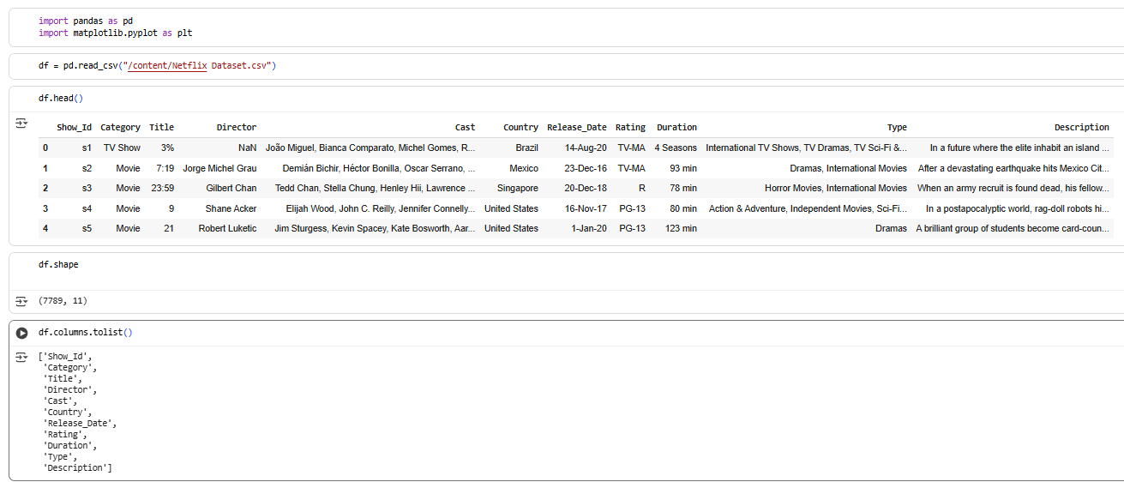
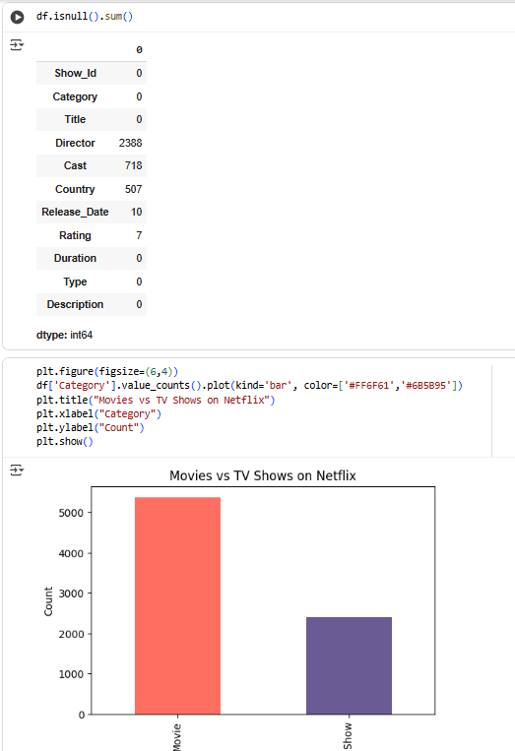
RESULTS1

Slide 7
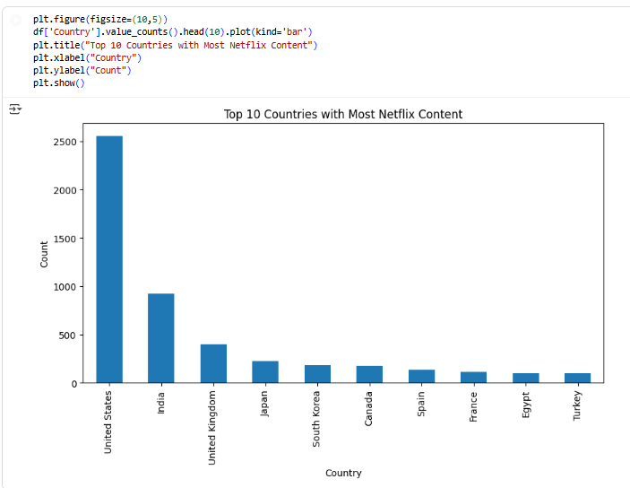
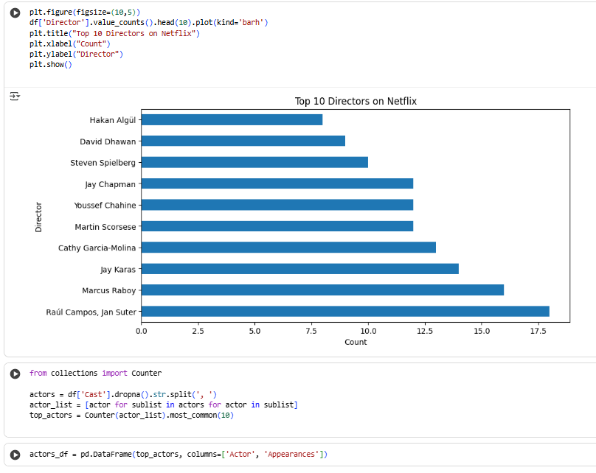
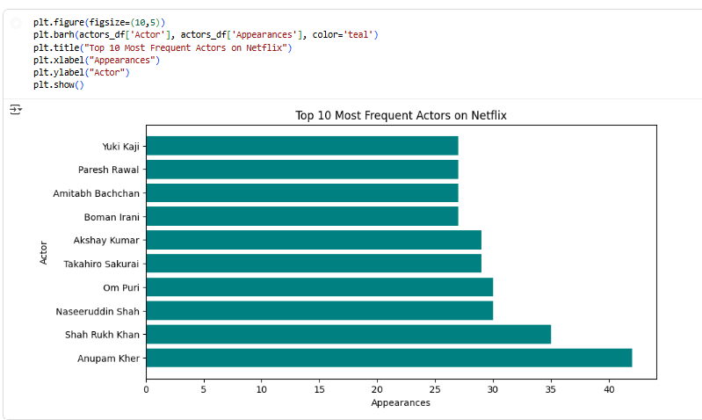
RESULTS2

Slide 8
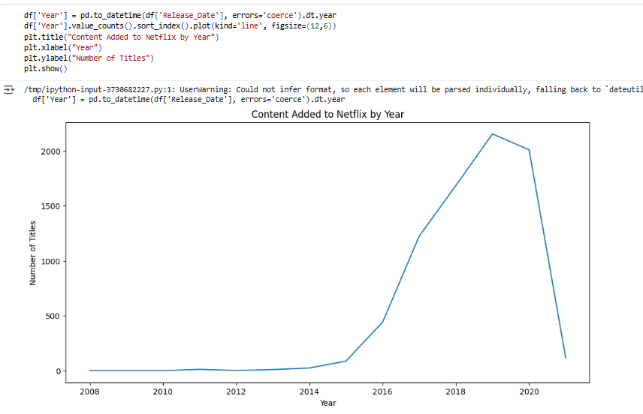
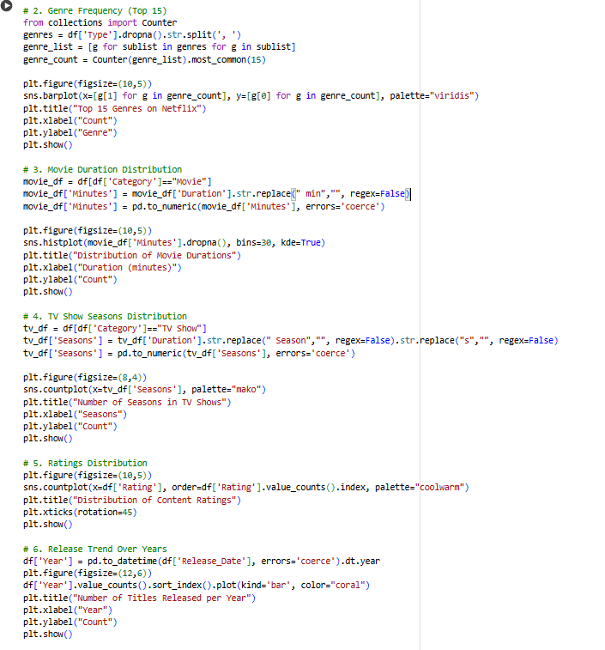
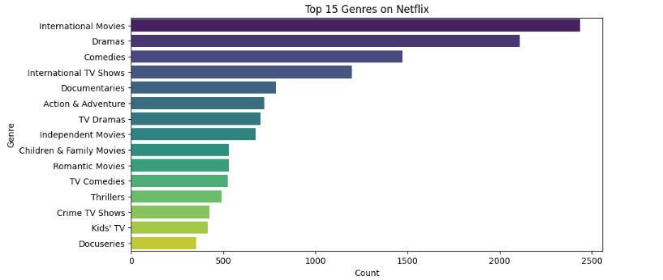
RESULTS3
[Add screen shots of your code or Chart(s) ]

Slide 9
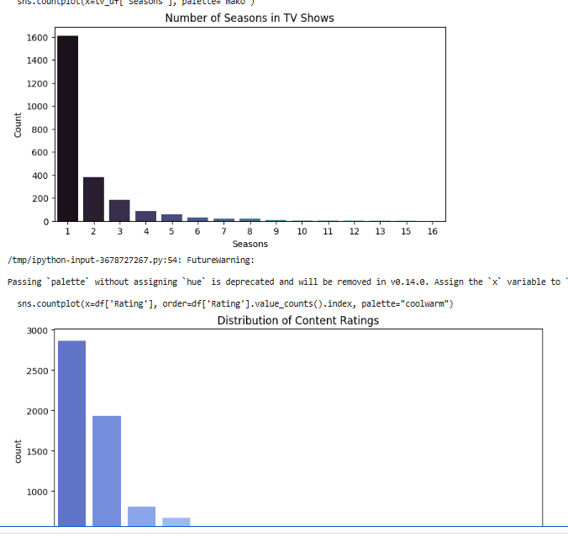
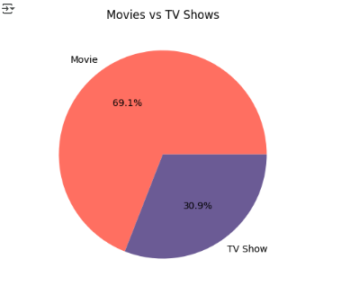
Results 4:

Slide 10
GitHub repository :
GitHub Repository : https://github.com/Sudarshan-CSE/VOIS_AICTE-MAJOR-PROJECT-Sudarshan-Khot.git

Slide 11
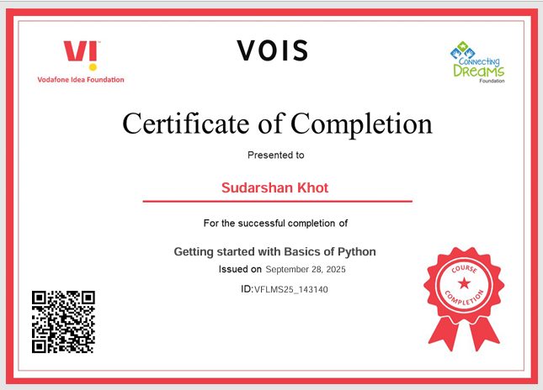
Getting started with Basics of Python Certificate

Slide 12
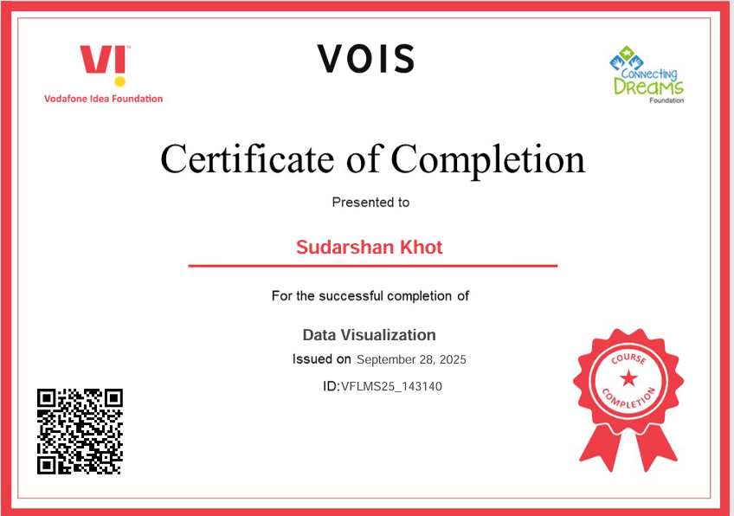
Data Visualization Certificate

Slide 13
Thank you
.
.

